Slide 1



Session 16
Features of ASP.NET Core 2.1
For Aptech Centre Use Only

Slide 2
Session Overview
Describe Razor Pages in ASP.NET Core 2.1
Explain Razor class libraries
Describe General Data Protection Regulation (GDPR) Support in Core 2.1
For Aptech Centre Use Only

Slide 3
ASP.NET Core 2.1 Features
Razor Pages
For Aptech Centre Use Only
Razor Class Libraries
General Data Protection Regulation (GDPR) support

Slide 4
Razor Pages
Preferred way to create user interfaces for Web apps
New feature in ASP.NET Core MVC designed to simplify Web app development that are more focused on pages
Helps increase productivity
Similar to a view in ASP.NET MVC
Provides two-way data binding
For Aptech Centre Use Only
One of the major differences between Razor pages and MVC is that model and controller
code are included within the Razor Page itself.

Slide 5
Benefits of Razor Pages
Improved Structure
For Aptech Centre Use Only
Self-Contained with Single Responsibility
Easier Form Creation

Slide 6
Razor Pages, Web App Files, and Folders 1-2
File/Folder Name | Description
wwwroot | Contains static assets such as style sheets and images.
Pages | Includes a sub-folder named Shared that has three files: _Layout.cshtml file _ValidationScriptsPartial.cshtml _CookieConsentPartial.cshtml
appsettings.json | Is a configuration file.
Program.cs | Configures application. | the | host | of | the | ASP.NET | Core
Startup.cs | Is one of the most important ones in the application and configures services and request pipeline.
Order of search for Razor Assets
Current Pages
For Aptech Centre Use Only
/Pages/Shared/
/Views/Shared/

Slide 7
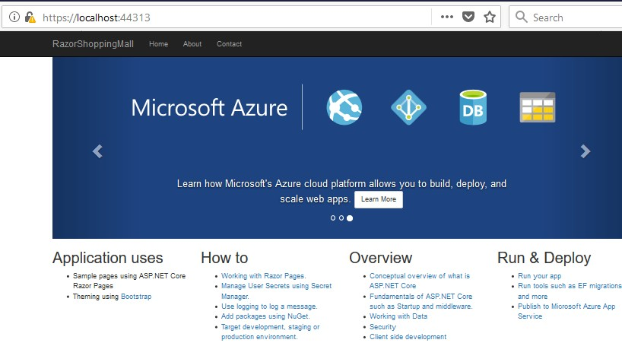
Razor Pages, Web App Files, and Folders 2-2
For Aptech Centre Use Only

Slide 8
Page Associations with URL Paths
/Pages/Index.cshtml
/Pages/Contact.cshtml
/Pages/Store/Contact.cshtml
/Pages/Store/Index.cshtml
For Aptech Centre Use Only
/ or /Index
/Contact
/Store/Contact
/Store or /Store/Index

Slide 9
Razor Class Libraries
Create a Razor-based UI as a library and share it across multiple projects.
This promotes reusability as the Razor class library can be reused across projects.
Razor SDK enables developers to build a Razor class library that can be packaged into a NuGet
package.
To make login functionality in apps easier, faster, and more secure, ASP.NET Core 2.1 also provides ASP.NET Core Identity as a Razor Class Library.
ASP.NET Core Identity is a membership mechanism to incorporate login functionality in ASP.NET Core apps.
Developers can use items such as Razor views, pages, controllers, page models, View components, and data models as part of a Razor Class Library.
For Aptech Centre Use Only

Slide 10
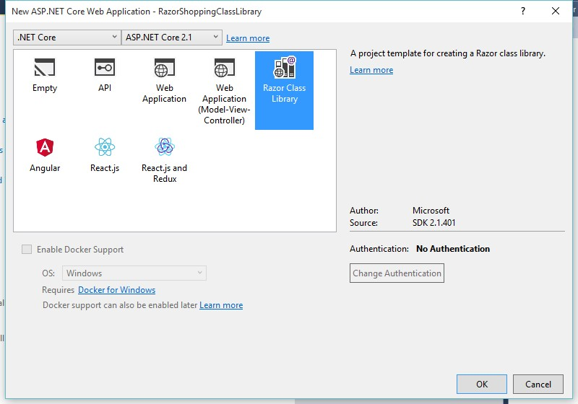
Creating Razor Class Libraries
For Aptech Centre Use Only
Selecting Razor Class Library Template

Slide 11
GDPR Support in ASP.NET Core (1-2)
Set of rules formulated to give European Union (EU) citizens greater control over their personal data.
Lays down provisions and requirements pertaining to data collation and processing.
Applies to an enterprise established in the EU that is processing the personal data of people residing in the EU.
To be GDPR compliant, organizations must put in place appropriate technical and organizational measures.
ASP.NET Core provides APIs and templates to help meet some of the GDPR requirements.
Project templates include extension points and stubbed markup which can be replaced by developers with the
organization's privacy and cookie use policy.
A cookie consent feature allows developers to prompt (and track) consent from users before storing personal data.
For Aptech Centre Use Only

Slide 12
GDPR Support in ASP.NET Core (2-2)
Some of the built-in GDPR support in Razor Pages and MVC projects created with
project templates:
CookiePolicyOptions and UseCookiePolicy are by default added in Startup.cs.
The _CookieConsentPartial.cshtml
partial view.
For Aptech Centre Use Only
The Pages/Privacy.cshtml page or Views/Home/Privacy.cshtml view provides a page to display an organization's privacy policy.
The _CookieConsentPartial.cshtml file generates a link to the Privacy page.

Slide 13
Summary
ASP.NET Core 2.1 offers several new and powerful features that improve productivity and performance such as Razor Pages, Razor Class Libraries and GDPR support.
Razor Pages is a new feature in ASP.NET Core MVC designed to simplify Web app development that are more focused on pages.
In ASP.NET Core 2.1, developers can create a Razor-based UI as a library and share it across multiple
projects.
GDPR is a set of rules and requirements pertaining to data collation and processing and applies to
enterprises in the EU that process personal data of people residing in the EU.
To be GDPR compliant, organizations must put in place appropriate technical and organizational measures.
ASP.NET Core provides APIs and templates to help meet some of the GDPR requirements.
For Aptech Centre Use Only

